Slide 2
Sink / Swim (Level – 1)

Slide 3
1. What is IDE?
(Level - 1: 1/10)

Slide 4
2. Regarding Modern Web Design match the following…
i.) HTML
ii.) CSS
iii.) JavaScript
iv.) PHP or similar
v.) CMS
a.) Backend
b.)Content Management
c.) Presentation
d.) Structure
e.) Behavior
(Level - 1: 2/10)

Slide 5
3. Full Form of API?
(Level- 1: 3/10)

Slide 6
4. Fill in the Blanks -
<div> element defines a _________ in a document.
<span> element defines an __________ in a document.
Block-Level Section
Inline Section
or
(Level- 1: 4/10)

Slide 7
5. Most Used encoding in HTML?
(Level- 1: 5/10)

Slide 8
6. Distinguish between Pre-Fix and Post-Fix?
X++;
++X;
(Level- 1: 6/10)

Slide 9
7. Which programming language is base for Android Development?
(Level- 1: 7/10)

Slide 10
8. Is there any possibility to create customized header file with C programming language?
(Level- 1: 8/10)

Slide 11
9. C is successor of which programming language?
(Level- 1: 9/10)

Slide 12
10. How a negative integer is stored in C/C++?.
(Level- 1: 10/10)

Slide 13
Build It!! (syntax error) (Level - 2)

Slide 14
Fill in the Blanks to set the background color to white in HTML –
<body _____="_FFFFFF">
(Level- 2: 1/8)

Slide 15
2. What is the result of 10 == 10 operation? In C/C++/JAVA?
(Level- 2: 2/8)

Slide 16
3. In C++, What would be the output for these statements?
x=3;
y = ++x; //statement 1
cout<<y<<x;
y = x++; //statement 2
cout<<y<<x;
(Level- 2: 3/8)

Slide 17
4. While using SPAN in HTML there is an error?
<p>
<span style="color=#000000;">
In this page we use span.
</span>
</p>
(Level- 2: 4/8)

Slide 18
5. Make some changes in the program to get the expected output ( 1 2 3 4 5 ) .
#include <stdio.h>
int main()
{ int i=0;
while(i++ < 5 )
{ printf("%d ",i); }
return 0;
}
(Level- 2: 5/8)

Slide 19
6. Fill in the blanks to display the image, "tree.jpg", at a 200px height and a 500px width:
<___ ___="tree.jpg" height="200px" alt=" _____=“_____" />
(Level- 2: 6/8)

Slide 20
7. Type in the code to define a recursive function calculating the factorial of the function parameter.
int fact(int x) {
if (x = 1) {
____1;
} else {
return x * __ (x - 1);
}
}
(Level- 2: 7/8)

Slide 21
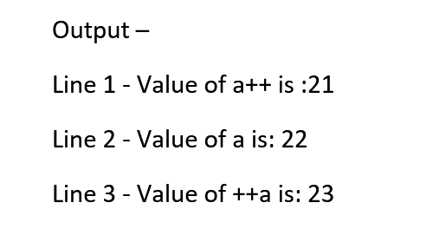
8. Remove the error to get desired output.
#include <iostream>
using namespace std;
main() {
int a == 21;
int c ;
c = a++;
cout << "Line 1 - Value of a++ is :" << c << endl ;
cout << "Line 2 - Value of a is :" << a << endl ;
c = a++;
cout << "Line 3 - Value of ++a is :" << c << endl ;
return 0;
}
(Level- 2: 8/8)

Slide 22
Logical Messsss (Logic error) (Level - 3)

Slide 23
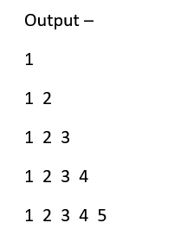
1. Remove Logical error to get desired output-
#include <stdio.h>
int main()
{
int i, j, rows;
printf("Enter number of rows: ");
scanf("%d",&rows);
for(i=1; i<rows; ++i)
{ for(j=1; j<=rows; ++j)
{ printf("%d ",j); }
printf("\n");
}
return 0;
}
(Level- 3: 1/6)

Slide 24
Edit the code to get the path directory in the field.
Expected Output - C:\user\new_folder\table
#include <stdio.h>
int main()
{
printf(“C:\user\new_folder\table”);
return 0;
}
(Level- 3: 2/6)

Slide 25
3. What to Use- GET/get or POST/post for better security?
<form action="url" method=“___">
(Level- 3: 3/6)

Slide 26
4. Fill in the blanks to get better security while using form tag in HTML:
<____ method="_____" action=“___">
<input type="text" name="name" >
< ______ type="submit" name="submit">
</ ______ >
(Level- 3: 4/6)

Slide 27

- Output - 15
TF1
5. Using JAVA, Use logic to get desired output-
x=TF1.getText( );
y=10;
z=x+y;
system.out.print(z);
(Level- 3: 5/6)

Slide 28
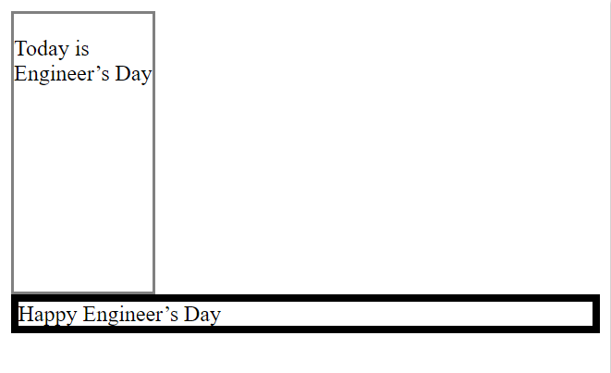
6. Use logic to get desired output in HTML –
(Hint - Don’t get confused in Block and Inline elements)
Code:
<span style="border:2px; height: 200px; width:100px; ">
<p>Today is Engineer’s Day </p>
</span>
<span style=" border: solid black 5px;">Happy Engineer’s Day</span>
Output –
(Level- 3: 6/6)

